Slide 1
Unit 1: Computational Thinking and Programming
1.1 Assigning Variables
Learning Objectives
Key Concepts
By the end of the lesson, students will be able to:
Algorithm
Define a variable as something that holds a value that can change.
Instructions and order
Identify values that can change in an algorithm.
Loops
Assign values such as text or numbers to variables
Variables
Create variables with meaningful names.
Values
Modify an existing variable in Scratch.
Changing data

Slide 2
Key Vocabulary
Skills
Variable
Writing algorithms
Value
Following instructions in order
Assign
Using loops
Variable assignment
Identifying changing values
Meaningful
Creating and modifying variables in Scratch
Temporary

Slide 3
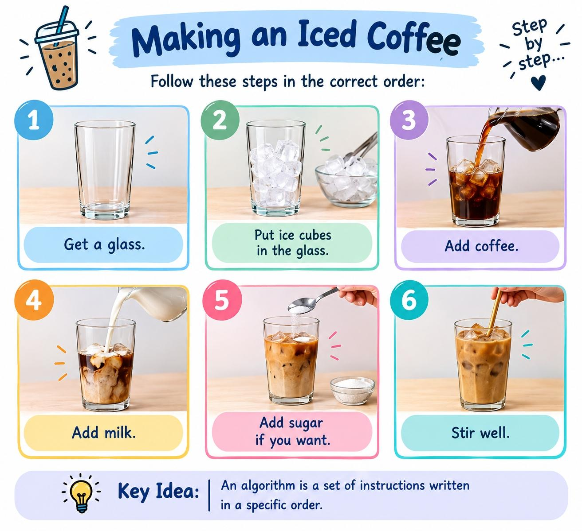
What is an Algorithm?
An algorithm tells us:
An algorithm is a set of instructions written in a specific order.
What to do → and in what order to do it.
Example: Making an Iced Coffee
Step 1: Get a glass.
Step 2: Put ice cubes in the glass.
Step 3: Add coffee.
Step 4: Add milk.
Step 5: Add sugar if you want.
Step 6: Stir well.

Slide 4
What is a Loop?
A loop repeats instructions.
“After making our iced coffee, imagine we want to stir it 5 times.”
Count-Controlled Loop
What is a Count-Controlled Loop?
A count-controlled loop repeats instructions a specific number of times.
Without a Loop
With a Loop
Stir the coffee.
Repeat 5 times:
Example:
Stir the coffee.
Repeat → Stir
Repeat 5 times:➡️ Stir the coffee
Stir the coffee.
We tell the loop how many times to repeat.
Another Example:
Stir the coffee.
Repeat 4 times:➡️ Move forward
Stir the coffee.

Slide 5
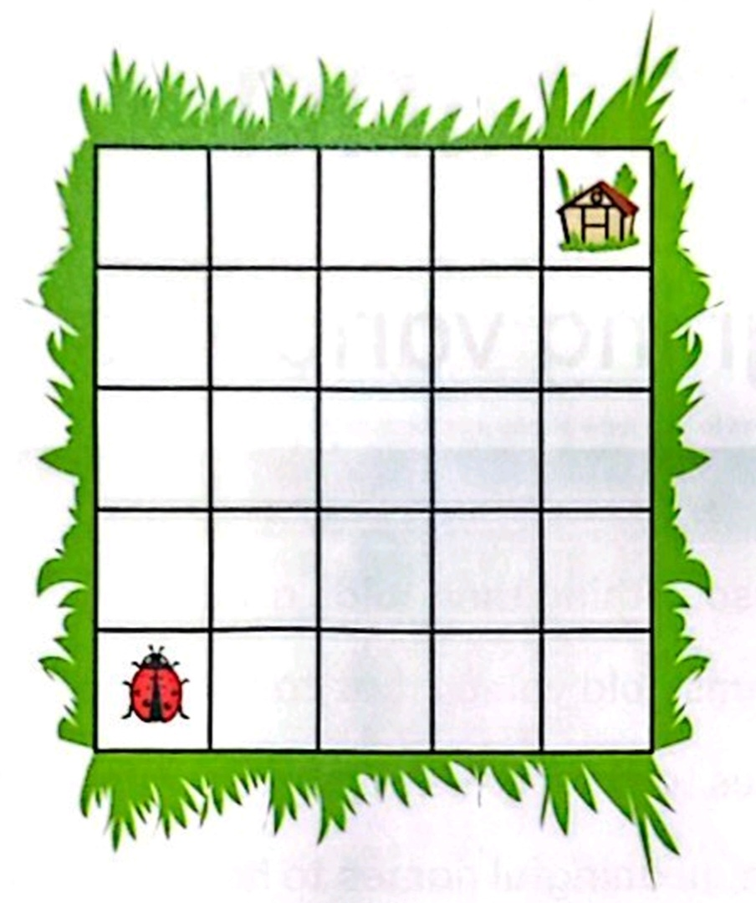
Let’s Apply It!
Help the Ladybug Reach the Bug HotelHelp the Ladybug Reach the Bug Hotel
The ladybug understands:
➡️ Move forward
↪️ Turn right
↩️ Turn left
Challenge 1
Write the instructions as a linear algorithm.
Challenge 2
Can you make your algorithm shorter using a count-controlled loop?

Slide 6
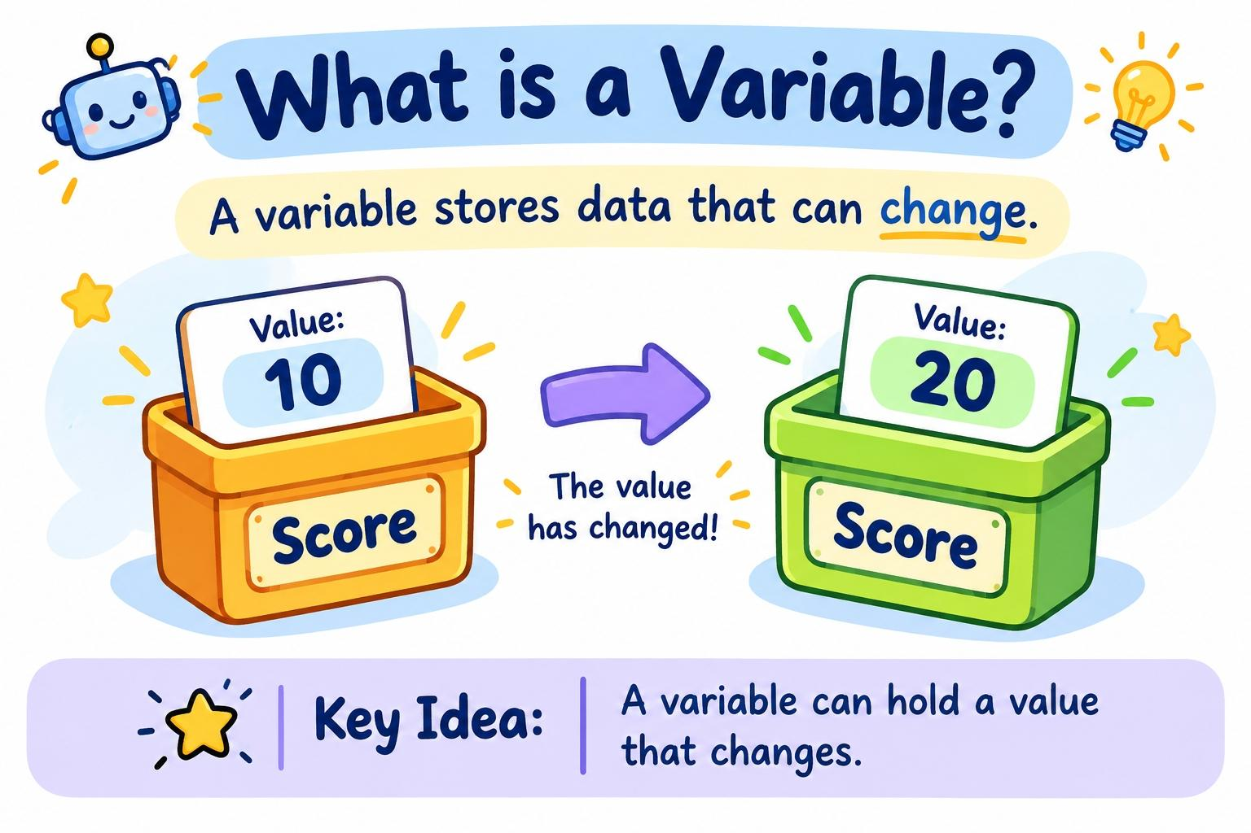
Introducing Variables
What is a Variable?
A variable stores data that can change.
Example:
Score = 10
Score = 20
The value has changed.
A variable can hold a value that changes.

